Slide 1
2022 Q2 Results Presentation
TA YA ELECTRIC WIRE & CABLE CO., LTD.
Stock Code: 1609
TA YA Group Overview & Financial Highlights
Company Spokesman：Chen,Chung-Kuang
2022/09/06

Slide 2
DISCLAIMER
The purpose of the briefing is to provide information, therefore will not be updated under any circumstances.
TA YA Group does not have any responsibility to update or correct any information in this presentation.
The information within the presentation does not hint future decisions or promise any solid validity.

Slide 3
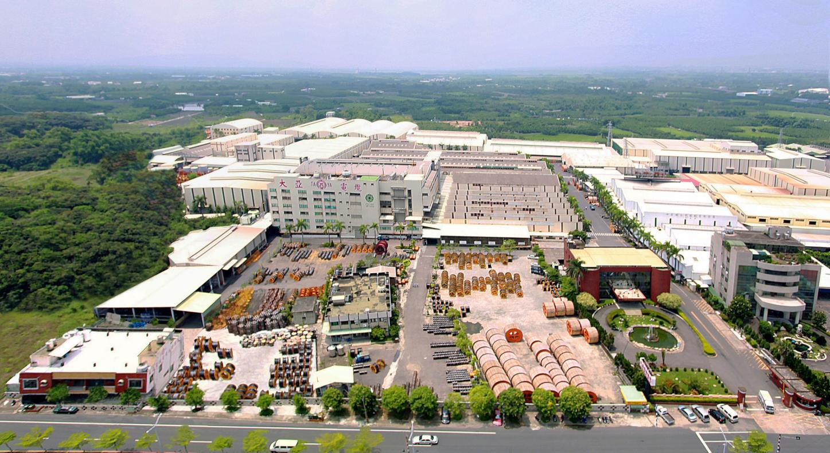
TA YA Headquarter
Found：1955
Capital：NTD 6.459 billion
Revenue：NTD 27.5 billion ( 2021 Consolidated Results)
Area：138,038 ㎡
Employee : 640
Product : Power Cable / Magnet Wire / Telecom Cable /
Optical Fiber Cable / Bonding Wire /
Residential Properties and Office Buildings/
Gold-palladium-plated copper wires/
Pd-coated bonding wires.

Slide 4




TA YA Group
The purpose of ESG be implemented in our vision
A leading brand in energy connection
Vision
A business trusted by employees, customers, shareholders, and society
A creator of harmonious environment and pristine homeland

Slide 5
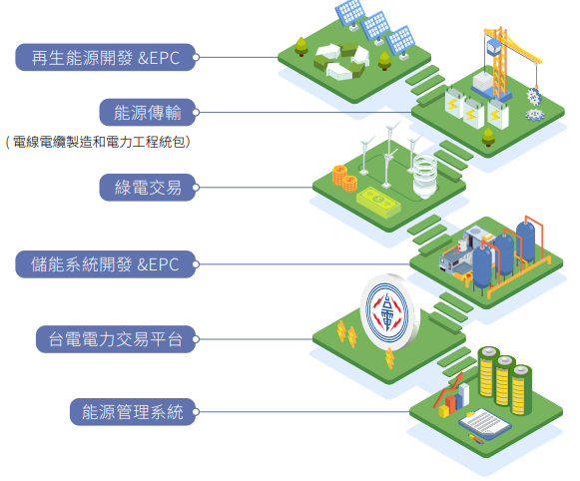
The Intergration of Renewable Energy Industry
Renewable energy development
Energy transmission
Energy transaction
Energy storage systems
Taipower AFC platform
Energy management systems

Slide 6

About TA YA Headquarters
Combined with 5 Business Groups
Energy and Telecom Communication Cable Business Group
Magnet Wires Business Group
New Business Development, Investment and Copper Management Business Group
Construction Business Group
Business
Administration Group
Operates the production, development, and sales of electricity and communication cables and monitors affiliated enterprises, including Ta Ho, AD, and Ta Ya Green Energy Technology Co., Ltd. .
Operates the production, development, and sales of enamel wires and monitors affiliated enterprises, including Heng Ya Electric Ltd. (Hong Kong), Heng Ya Electric (Kunshan) Co., Ltd., and Ta Yi Plastic Co., Ltd..
Operates building construction and sales management.
Operates the production, development, and sales of encapsulation solder wires, copper procurement, management of the Taipei Branch, and the evaluation of overseas investments.
Coordinates all groups, responds demands of stakeholders rationality, fulfills comprehensive effectiveness of groups, keeps sustainable growing.

Slide 7


TAYA Solar Energy
Installation with 2.89MW for solar power plant on rooftop in the Headquarter of Kuan Miao.
Cooperation with Taiwan Sugar for 6.94MW on rooftop by thousands of square meters.
Completed the change in land project for 71 hectares in Syuejia District, installed with 76MW which is the 1st successful land change on a private large-scale land over more than 30 hectares in Taiwan.
The plant of Kuan Miao, Tainan individually installed with “TAYA Energy Storage Microgrid ” System of 600kWh 200kWp, combining with storage, electric facilities, environment control and grid information as one, providing a full-service for power control.
In future, TAYA proactively develops large-scale rooftops on enterprises and ground-mounted solar power plants, and
our target in 2023 will be over 240MW.
Notes:
ps.
1.台糖畜殖事業部2284.91kw+ 台糖南區2,653.695kw+ 東海豐1,997.75kw = 6,936.355KW
2.學甲 75,696.60kw

Slide 8


TAYA Green Energy Technology
Bosi Solar Energy
Touch Solar Power
Bravo Solar Power
Sin Jhong Solar Power
Jhih-Guang Energy
Bo Yao Power

Slide 9

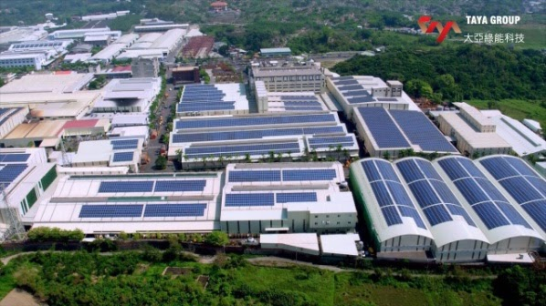
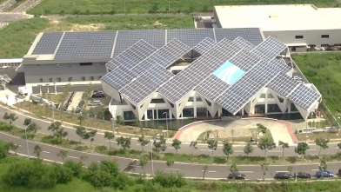
Plan for Renewable Energy
Solar Energy
The ideal of establishing Taya Green, and the cooperation with Hengs to develop field of solar energy, Taya Group exclaims to be leading brand in energy connection by actions.
Importing PV-ESCO (Photovoltaic-Energy Service Company) : to reduce people's cost of installing PV.
Provide PV building service, such as Self-use, Roof, Ground-mounted, Floating, and Fishery & Electricity Symbiosis.

Slide 10
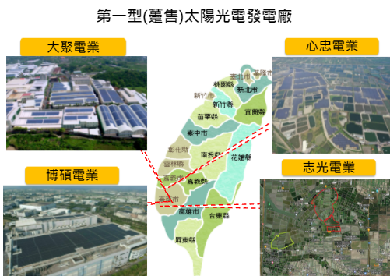
Type I Solar Power Plant
Touch Solar Power
Sin Jhong Solar Power
Bravo Solar Power
Jhih-Guang Energy
We have accomplished building 122 MW, by investing approximately 6 billion, and the degree of electricity could be generated to 160 million every year.
Goal in 2023 : to integrate 250 MW grid-connected power generation of solar energy..

Slide 11
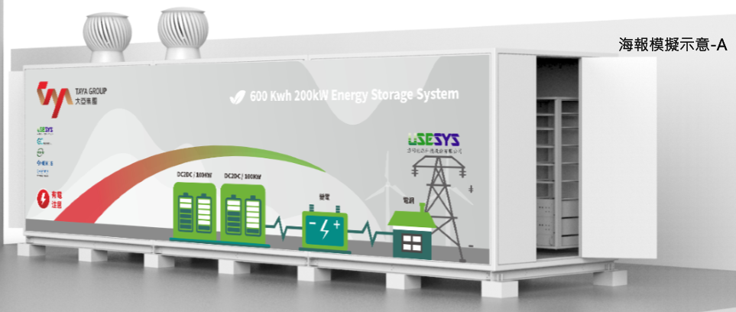
The Market of Energy Storage in Taiwan
Electric Vehicle Charging Station :
Dispatching in Peak and Off-Peak Hour
The Balance of Electrical Grid
Keeping the Charging Quality
Renewable Power Plant :
Smoothing of the Renewable Power Production Curve
Energy Transmission Over Time
High Energy User Clause :
The users whose contract capacity is over 5,000kWh a month are required to buy 10% of that from green source, or build energy storage in 5 years.
Demands of Electric Companies :
Dispatching
The Stable of Electric Grid
The Balance of User’s Load

Slide 12
Energy Storage System
TPC plans to complete 590MW of energy storage systems by 2025.
  (Include160MW of energy storage equipment and 430MW ancillary services, for regulating the unstable characteristics of renewable energy)
Starting on July 1, 2022, the “ Taipower’s Power Trading Platform", for suppliers to provide Automatic Frequency Control (AFC) service.
As of January 2022, six colleagues of TAYA have gained the Tai Power trading platform license.
Heavy energy consumers with more than 5,000kW demands are required to build 10% of renewable energy or purchase green electric. As a result, large demand for renewable energy and energy storage system business is expected.
Joined the Taipower Trading Platform in Mid 2022.
25MW of energy storage system will be completed every year.
Expect to complete 100MW of Energy Storage System in 2025.

Slide 13

  Financial Highlights
Consolidated Operating Performance

Slide 14
  Financial Highlights
Sales Volume Of Various Products:
Sales Volume : Ton

Slide 15
  Financial Highlights
Sales Volume Of Various Products:

Slide 16
  Financial Highlights
2022 Q2 The ratio of Product sales volume

Slide 17
  Financial Highlights
2022 Q2 The ratio of Product sales figures

Slide 18
  Financial Highlights
Consolidated Statements of Income : 2022Q2
Unit: Thousand of NTD, except for EPS in NTD
Item | 2022Q2 |  | 2021Q2 |  | Annual Growth Rate
Net Sales | 13,728,485 | 100.0 | 13,183,573 | 100.0 | 4.1
Operating Costs | 12,538,823 | 91.3 | 11,759,557 | 89.2 | 6.6
Gross Profit | 1,189,662 | 8.7 | 1,424,016 | 10.8 | (16.5)
Unrealized Gain On The Transactions With Associates | 10,771 | 0.1 | 0 | 0.0 | -
Realized Gain On The Transactions With Associates | 593 | 0.0 | 0 | 0.0 | -
Net Profit | 1,179,484 | 8.6 | 1,424,016 | 10.8 | (17.2)
Operating Expenses | 636,038 | 4.6 | 580,161 | 4.4 | 9.6
Net Profit | 543,446 | 4.0 | 843,855 | 6.4 | (35.6)
Non-Operational Income | (194,884) | (1.4) | 247,209 | 1.9 | (178.8)
Net Profit After Tax | 158,674 | 1.2 | 796,061 | 6.0 | (80.1)
(Attributable to Shareholders of the Parent )
EPS | 0.25 |  | 1.31 |  | (80.9)

Slide 19
  Financial Highlights
Operating Performance Per Share
Item / Year | 2017 | 2018 | 2019 | 2020 | 2021 | 2022Q2
Earnings Per Share | 0.83 | 0.83 | 0.86 | 1.41 | 2.3 | 0.25
Cash Dividend Per Share | 0.35 | 0.3 | 0.3 | 0.35 | 0.35 | NA
Stock Dividend Per Share | 0 | 0.4 | 0 | 0.35 | 0.60 | NA
Return on Equity | 7.15% | 7.15% | 7.09% | 11.79% | 14.36% | 2.25%
Net Value Per Share | 11.27 | 11.11 | 11.92 | 13.05 | 15.19 | 15.11
Operating Cash Flow Per Share | (0.33) | 0.75 | 1.02 | 0.99 | (1.97) | (1.86)

Slide 20
  Financial Highlights
Green Power Industry Performance

Slide 21
  Financial Highlights
Green Power Industry Performance
Unit: Thousand of NTD

Slide 22

Q & A
TA YA ELECTRIC WIRE & CABLE CO., LTD.
Stock Code: 1609

