Slide 1
2020 Q2 Investor Conference
TA YA ELECTRIC WIRE & CABLE CO., LTD.
Stock Code: 1609
TA YA Group Overview & Financial Highlights
Chen,Chung-Kuang
Business Administration Group Deputy General Manager and Spokesperson
2020/9/11

Slide 2
DISCLAIMER
The purpose of the briefing is to provide information, therefore will not be updated under any circumstances.
TA YA Group does not have any responsibility to update or correct any information in this presentation.
The information within the presentation does not hint future decisions or promise any solid validity.

Slide 3

AGENDA
TAYA GROUP
Ⅰ. TA YA Group Overview
Ⅱ. Financial Highlights
Ⅲ. IR Contact

Slide 4
Ⅰ. TA YA Group Overview

Slide 5
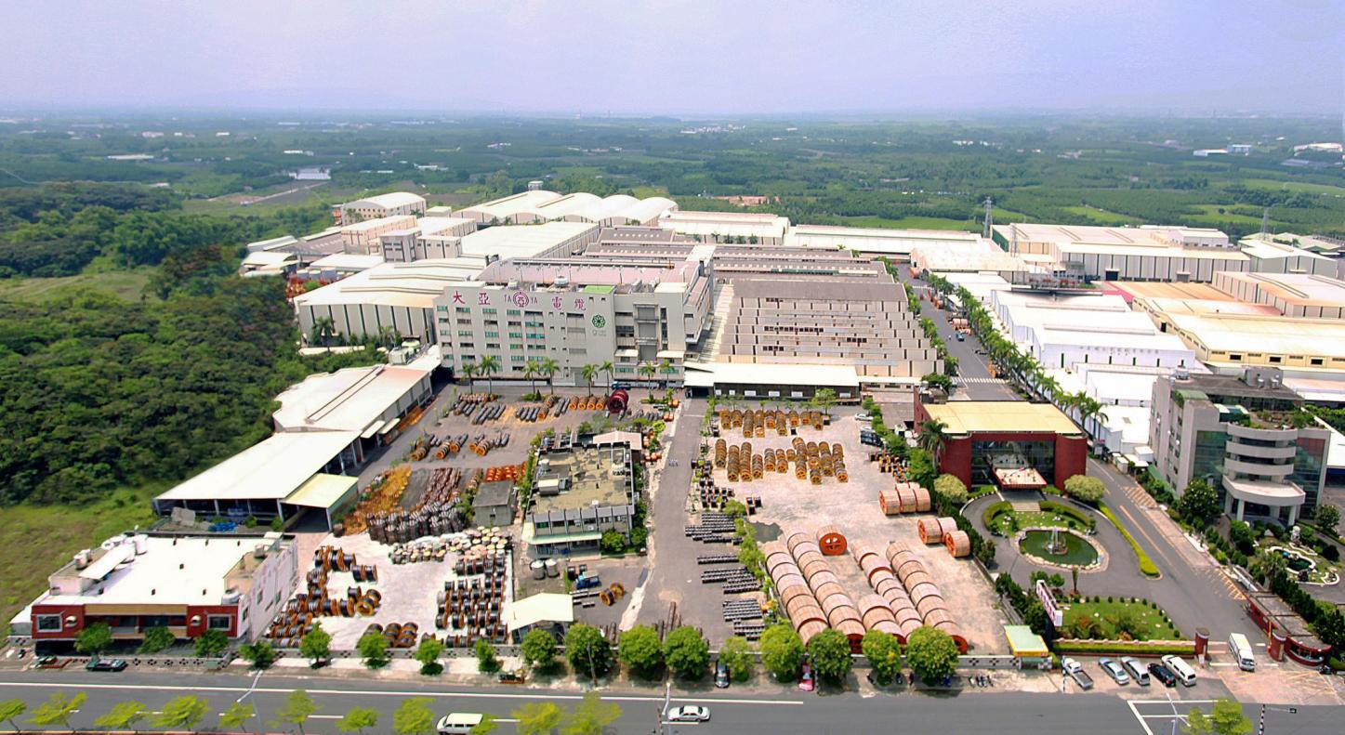
TA YA Headquarter
Found：1955
Capital：NTD 5.951 billion
Revenue：NTD 18.15 billion ( 2019 Consolidated Results)
Area：138,038 ㎡
Employee : 625
Product : Power Cable / Magnet Wire / Telecom Cable /
Optical Fiber Cable / Bonding Wire /
Residential Properties and Office Buildings

Slide 6

Continuous improvements
Business
Philosophy
To become
A leading brand in energy connection
A creator of harmonious environment
and pristine homeland
A business trusted by employees, customers, shareholders, and society
Vision
Philosophy
Core Values
TA YA GROUP
Enlightened Employees, Satisfied Customers,
Positive Shareholders, Pristine Homeland
Continuous Improvements,
Mutual Benefits,
Pragmatism,
Innovation & Changes.

Slide 7
Milestones
345kV power cables passed tests by TPC; environmental-friendly power cables were certified by EPA
entered into the renewable energy business
listed on the TWSE
founded at Tainan
1955
1986
1988
1995
2008
2012
2012
2014
2020
established Ta Ya Pristine Homeland Foundation
Ta Ya 65th anniversary:
the year of brand communication
relocated headquarter to Guanmiao
161kV power cables passed tests by TPC

Slide 8

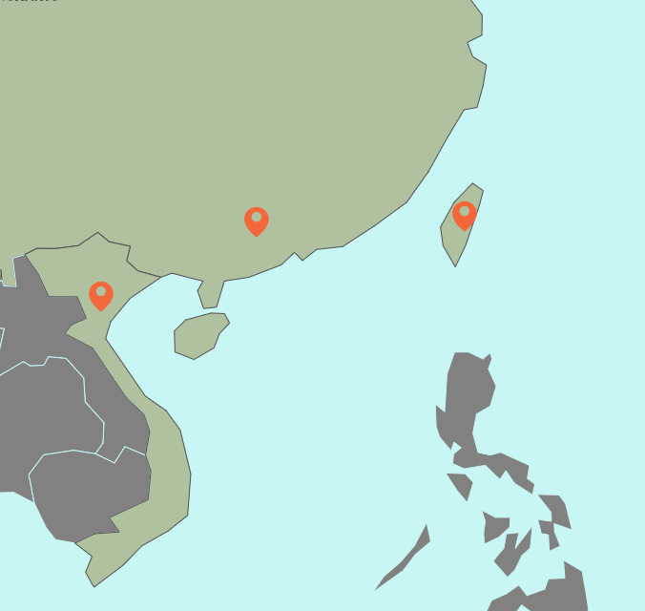
TA YA Group Overview
OVERVIEW OF GROUP
Union Storage Energy System Co., Ltd.
Amit System Service Co., Ltd.
TA YA Innovation Investment Co., Ltd.
HENG YA Electric (Kunshan) Ltd.
TA YA Venture Capital Co., Ltd.
UNITED Electric Industry Co., Ltd.
CUPRIME Material Co., Ltd.
HENG YA Electric Ltd.
TA YA Electric Wire & Cable Co.,Ltd.
TA HENG Electric Wire & Cable Co., Ltd.
TA HO Engineering Co., Ltd.
Ta Ya (Vietnam) Electric Wire & Cable Co., Ltd.
AD Engineering Co., Ltd.
TA YI Plastic Co., Ltd.
TA YA Green Energy Technology Co., Ltd.
Bosi Solar Energy Co., Ltd.
Touch Solar Power Co., Ltd.
Bravo Solar Power Co., Ltd.
Sin Jhong Solar Power Co., Ltd.

Slide 9
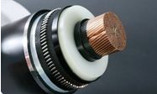
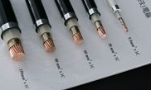
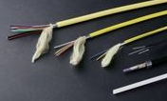
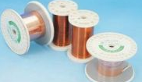
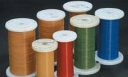
Business Group Overview
Energy & Telecom Cable
Magnet Wires

Slide 10

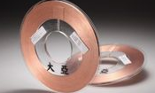
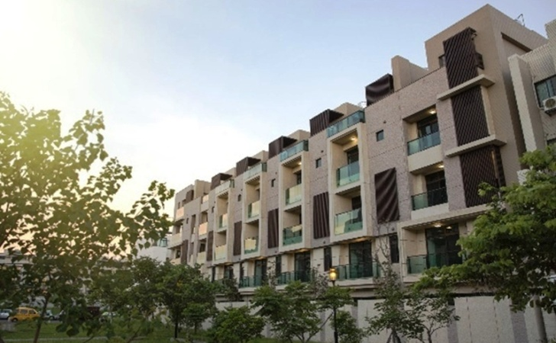
Business Group Overview
Bonding Wires
Construction Business Group

Slide 11
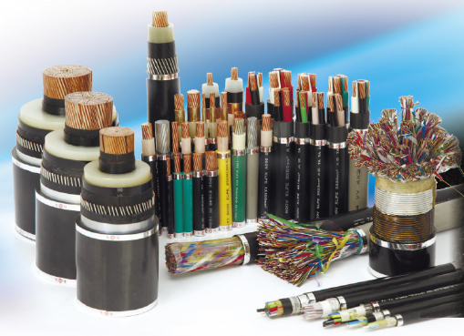
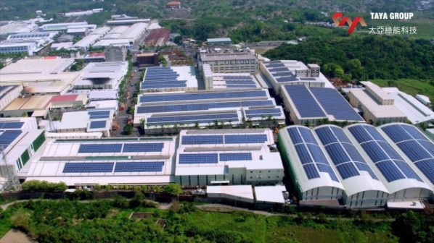
  A comprehensive system from 600V to 345kV has been set up. We are the first wire and cable company in Taiwan that develops the 345 kV system successfully and wins the engineering contract from TPC.
  We also provide construction and maintenance services for cable lines.
Energy & Telecom Cable Business Group

Slide 12
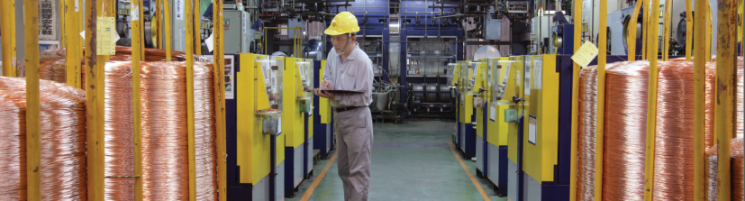
  We have production bases in Taiwan, China, and Vietnam. Magnet wires have been sold domestically and overseas for more than 40 years. Based on the professional production experience for many years, we gradually develop magnet wires, flat wires and TILWs of different characteristics.
Magnet Wire
Business Group

Slide 13
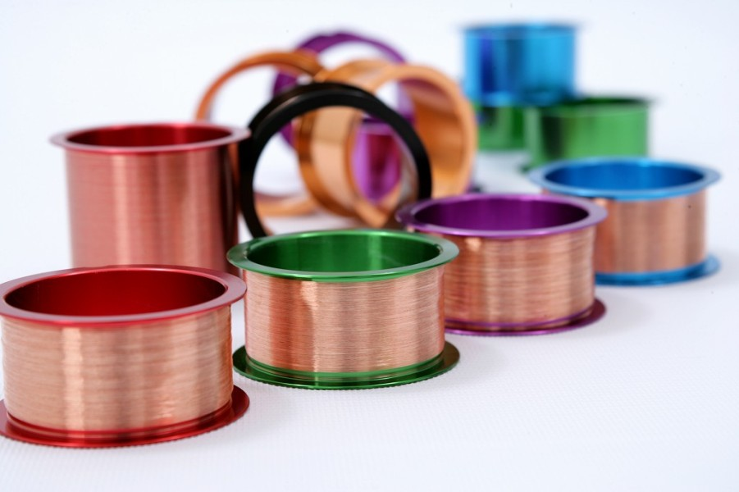
  The major products include copper bonding wires, au-pd coated copper wires, and pd-coated bonding wires and are suitable for the IC packaging industry.
Bonding Wires
Business Group

Slide 14
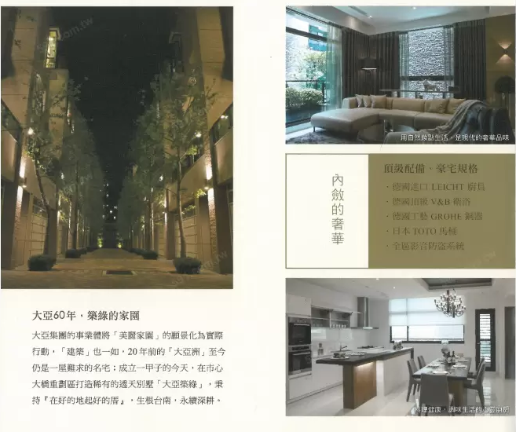
-Ta Ya Green Residence-
Total 14 units.
4 . 5F terrace house with elevator.
Construction Business Group

Slide 15
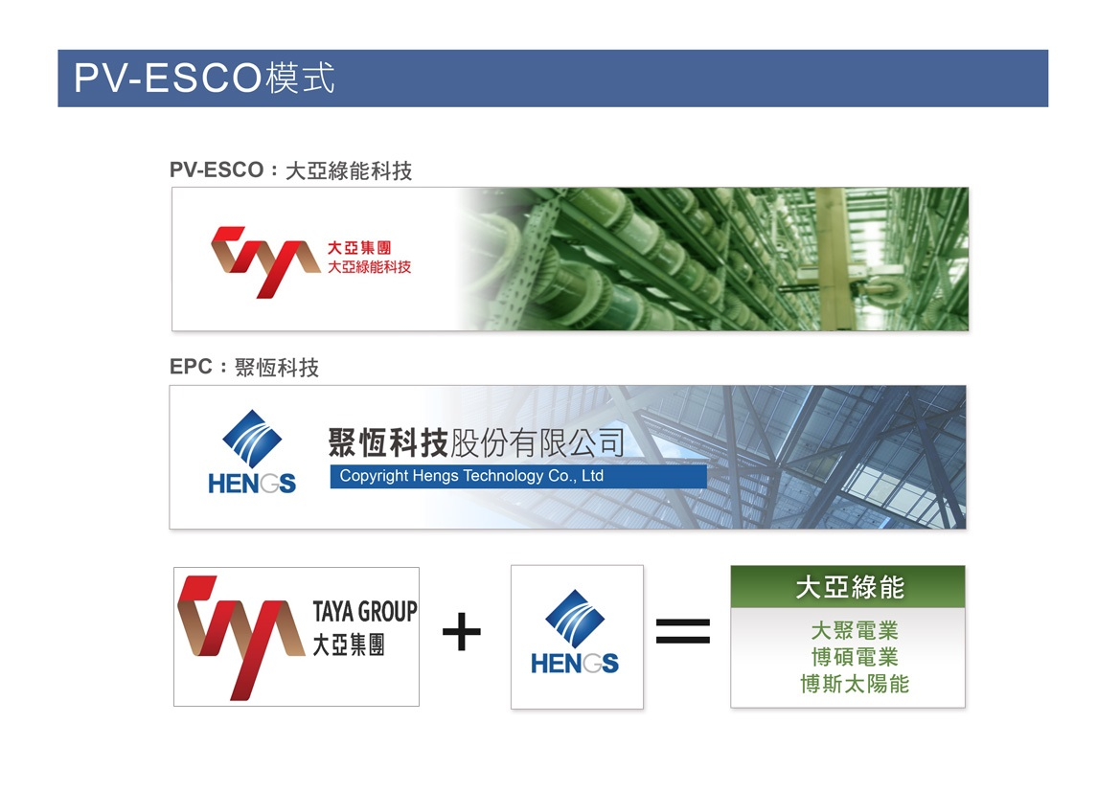
Business Diversification

Slide 16
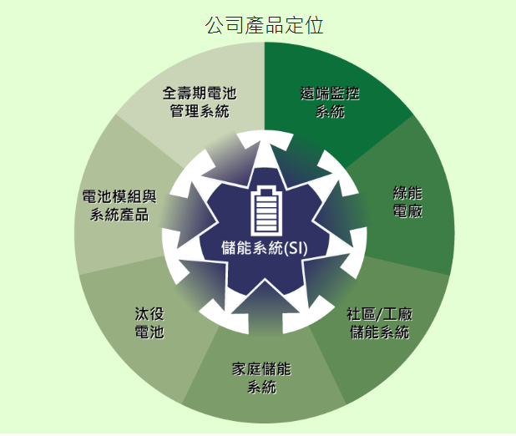

USESYS was founded in 2017 and joined venture between TAYA, Shilin Electric and Cadmen. Major business：Lithium Battery, Storage System, Key Parts R&D
Union Storage Energy System Co., Ltd.
Storage Key Product and Technology
EV Repurposing Battery
Storage System

Slide 17
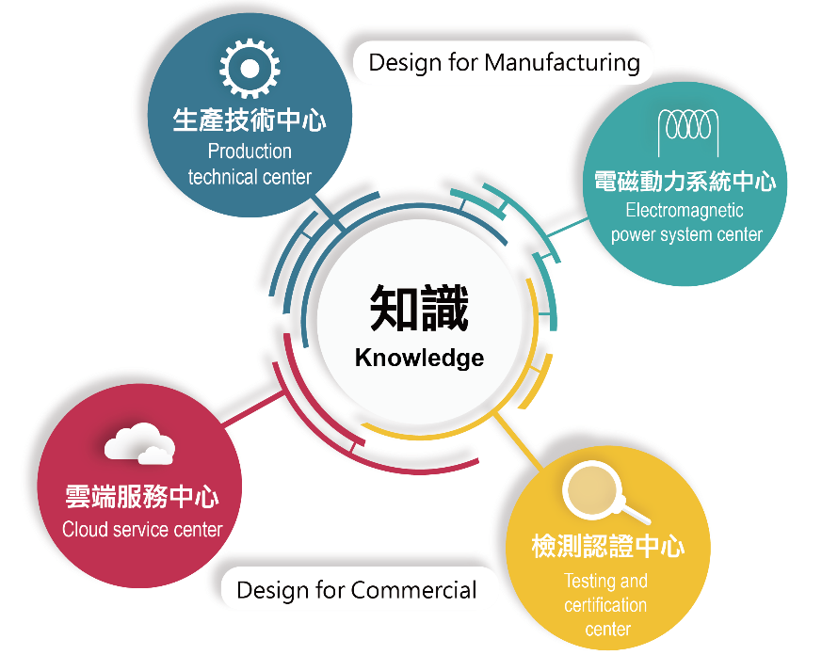

AMIT system service Ltd. was founded in Nov., 2016. We emphasize optimization of practical and knowledge services to assist parameterization, modularization and standardization for production technology of Taiwan industrial chain manufacturers by using software tool and cloud platform for global market. Our mission is to lead domestic motor industry into global proactive market.
協創系統科技
AMIT System Service LTD.
Design Services：
Motor Design
Motor Driving System Design
Optimization of Power Electronic System Designs
Solenoid Design
Electromechanical Integration System Design
Algorithm Design

Slide 18


TAYA Group First Year of Brand Communication Connect the World Moving Steady Forward

Slide 19
Ⅱ. Financial Highlights

Slide 20
  Financial Highlights
Consolidated Statements of Income : June 30, 2020
Unit: Thousand of NTD, except for EPS in NTD
Period | 2020 Q2 |  | 2019 Q2 |  | 2020 Q1 |  | Annual Growth Rate | Quarterly Growth Rate
Item | Amounts | % | Amounts | % | Amounts | % | % | %
Net Sales | 8,173,709 | 100.0 | 8,958,863 | 100.0 | 3,957,011 | 100.0 | (8.8) | 106.6
Operating Costs | 7,640,515 | 93.5 | 8,239,984 | 92.0 | 3,695,318 | 93.4 | (7.3) | 106.8
Gross Profit | 533,194 | 6.5 | 718,879 | 8.0 | 261,693 | 6.6 | (25.8) | 103.7
Operating Expenses | 476,782 | 5.8 | 450,604 | 5.0 | 224,561 | 5.7 | 5.8 | 112.3
Net Profit | 56,412 | 0.7 | 268,275 | 3.0 | 37,132 | 0.9 | (79.0) | 51.9
Non-Operational Income (Expenditure) | 528,692 | 6.5 | 21,457 | 0.2 | 202,794 | 5.1 | 2,364.0 | 160.7
Net Profit After Tax (Attributable to Shareholders of the Parent) | 457,902 | 5.6 | 209,848 | 2.3 | 139,807 | 3.5 | 118.2 | 227.5
EPS | 0.78 |  | 0.36 |  | 0.24

Slide 21
  Financial Highlights
Consolidated Statements of Income : April,31~June 30, 2020
Unit: Thousand of NTD, except for EPS in NTD
Period | Apr.~ Jun. 2020 |  | Apr.~ Jun. 2019 |  | Jan.~Mar. , 2020 |  | Annual Growth Rate | Quarterly Growth Rate
Item | Amounts | % | Amounts | % | Amounts | % | % | %
Net Sales | 4,216,698 | 100.0 | 4,489,345 | 100.0 | 3,957,011 | 100.0 | (6.1) | 6.6
Operating Costs | 3,945,197 | 93.6 | 4,161,922 | 92.7 | 3,695,318 | 93.4 | (5.2) | 6.8
Gross Profit | 271,501 | 6.4 | 327,423 | 7.3 | 261,693 | 6.6 | (17.1) | 3.7
Operating Expenses | 252,221 | 6.0 | 224,590 | 5.0 | 224,561 | 5.7 | 12.3 | 12.3
Net Profit or Loss | 19,280 | 0.5 | 102,833 | 2.3 | 37,132 | 0.9 | (81.3) | (48.1)
Non-Operational Income (Expenditure) | 325,898 | 7.7 | 34,687 | 0.8 | 202,794 | 5.1 | 839.5 | 60.7
Net Profit After Tax | 318,095 | 7.5 | 95,591 | 2.1 | 139,807 | 3.5 | 232.8 | 127.5
EPS | 0.54 |  | 0.17 |  | 0.24 |  | - | -

Slide 22
  Financial Highlights
Consolidated Statements of Income : April,31~June 30, 2020
Unit: Thousand of NTD, except for EPS in NTD
Period | Apr.~ Jun. 2020 |  | Apr.~ Jun. 2019 |  | Jan.~Mar. , 2020 |  | Annual Growth Rate | Quarterly Growth Rate
ITEM | Amounts | % | Amounts | % | Amounts | % | % | %
Net Sales | 4,216,698 | 100.0 | 4,489,345 | 100.0 | 3,957,011 | 100.0 | (6.1) | 6.6
Operating Costs | 3,945,197 | 93.6 | 4,161,922 | 92.7 | 3,695,318 | 93.4 | (5.2) | 6.8
Gross Profit | 271,501 | 6.4 | 327,423 | 7.3 | 261,693 | 6.6 | (17.1) | 3.7
Operating Expenses | 252,221 | 6.0 | 224,590 | 5.0 | 224,561 | 5.7 | 12.3 | 12.3
Net Profit | 19,280 | 0.5 | 102,833 | 2.3 | 37,132 | 0.9 | (81.3) | (48.1)
Non-Operational Income | 325,898 | 7.7 | 34,687 | 0.8 | 202,794 | 5.1 | 839.5 | 60.7
Net Profit After Tax (Attributable to Shareholders of the Parent) | 318,095 | 7.5 | 95,591 | 2.1 | 139,807 | 3.5 | 232.8 | 127.5
EPS | 0.54 |  | 0.17 |  | 0.24 |  | - | -

Slide 23
  Financial Highlights
Annual Operating Performance

Slide 24
  Financial Highlights
Operating Performance Per Share
Unit: NTD
Item / Year | 2015 | 2016 | 2017 | 2018 | 2019 | 2020Q2
Earnings Per Share | (0.97) | 0.05 | 0.83 | 0.83 | 0.86 | 0.78
Cash Dividend Per Share | 0 | 0 | 0.35 | 0.3 | 0.3 | 0
Stock Dividend Per Share | 0 | 0 | 0 | 0.4 | 0 | 0
Return on Equity | -7.97% | 0.44% | 7.15% | 7.15% | 7.09% | 6.47%
Net Value Per Share | 11.34 | 11.17 | 11.27 | 11.11 | 11.62 | 12.25
Operating Cash Flow Per Share | 0.95 | 0.19 | (0.33) | 0.75 | 1.02 | 1.94

Slide 25
  Financial Highlights
Consolidated Statements of Financial Position:
Unit: Million of NTD
Period |  | Assets | Jun.30, 2020 |  | Jun.30, 2019 |  | Mar. 31, 2020
Assets
 | Current Assets |  | Amounts | % | Amounts | % | Amounts | %
 |  | Cash and Cash Equivalents | 2,921 | 13.27 | 3,036 | 14.5 | 3,645 | 17.03
 |  | Financial Assets at Fair Value through Profit or Loss - Current | 572 | 2.6 | 380 | 1.81 | 629 | 2.94
 |  | Financial Assets at Fair Value through other comprehensive income | 24 | 0.11 | 4 | 0.02 | 20 | 0.09
 |  | Financial Assets at Amortized Cost - Current | 244 | 1.11 | 189 | 0.9 | 206 | 0.96
 |  | Contract Assets-Current | 63 | 0.29 | 298 | 1.42 | 131 | 0.61
 |  | Net Notes Receivable | 195 | 0.89 | 222 | 1.06 | 281 | 1.31
 |  | Net Accounts Receivable | 2,608 | 11.85 | 2,751 | 13.14 | 2,409 | 11.25
 |  | Inventory | 3,110 | 14.13 | 3,520 | 16.81 | 3,125 | 14.6
 |  | Other Current Assets | 313 | 1.42 | 775 | 3.7 | 744 | 3.48
 |  | Total Current Assets | 10,050 | 45.67 | 11,175 | 53.36 | 11,190 | 52.27

Slide 26
  Financial Highlights
Consolidated Statements of Financial Position:
Unit: Million of NTD
Period |  |  | Assets | Jun.30, 2020 |  | Jun.30, 2019 |  | Mar. 31, 2020
Assets
 | Non-Current Assets |  |  | Amounts | % | Amounts | % | Amounts | %
 |  | Financial Assets at Fair Value through Profit or Loss - Non-Current |  | 1,728 | 7.85 | 1,159 | 5.53 | 1,453 | 6.79
 |  | Financial Assets at Fair Value through OCI - Non-Current |  | 909 | 4.13 | 791 | 3.78 | 870 | 4.06
 |  | Investments Accounted for Using Equity Method |  | 793 | 3.6 | 820 | 3.92 | 787 | 3.68
 |  | Property, Plant And Equipment |  | 5,413 | 24.59 | 4,762 | 22.74 | 4,837 | 22.6
 |  | Right-of-Use Asset |  | 458 | 2.08 | 430 | 2.05 | 465 | 2.17
 |  | Investment Property-Net |  | 1,101 | 5 | 1,104 | 5.27 | 1,103 | 5.15
 |  | Other Non-Current Assets |  | 1,559 | 7.08 | 703 | 3.35 | 699 | 3.28
 |  | Total Non-Current Assets |  | 11,961 | 54.33 | 9,769 | 46.64 | 10,214 | 47.73
 |  | Total Assets |  | 22,011 | 100.00 | 20,944 | 100.00 | 21,404 | 100.00

Slide 27
  Financial Highlights
Consolidated Statements of Financial Position:
Unit: Million of NTD
Period |  |  | Liability | Jun.30, 2020 |  | Jun.30, 2019 |  | Mar. 31, 2020
Liability and Equity
 | Liability |  |  | Amounts | % | Amounts | % | Amounts | %
 |  | Current Liability
 |  | Short-term Debt |  | 4,502 | 20.45 | 3,739 | 17.85 | 4,216 | 19.7
 |  | Short-term Notes And Bills Payable |  | 590 | 2.68 | 760 | 3.63 | 755 | 3.53
 |  | Financial Liabilities At Fair Value Through Profit Or Loss - Current |  | 104 | 0.47 | 2 | 0.01 | 28 | 0.13
 |  | Contract Liability-current |  | 152 | 0.69 | 157 | 0.75 | 195 | 0.91
 |  | Notes Payable |  | 75 | 0.34 | 57 | 0.27 | 71 | 0.33
 |  | Accounts Payable |  | 584 | 2.65 | 530 | 2.53 | 500 | 2.34
 |  | Provisions |  | 120 | 0.55 | 113 | 0.54 | 113 | 0.53
 |  | Leased Liability |  | 17 | 0.08 | 19 | 0.09 | 19 | 0.09
 |  | Current portion of long-term loans |  | 1,067 | 4.85 | 2,004 | 9.57 | 1977 | 9.24
 |  | Other Current Liabilities |  | 1,280 | 5.82 | 627 | 2.99 | 521 | 2.43
 |  | Total Current Liabilities |  | 8,491 | 38.58 | 8,008 | 38.23 | 8,395 | 39.23

Slide 28
  Financial Highlights
Consolidated Statements of Financial Position:
Unit: Million of NTD
Period |  | Liability | Jun.30, 2020 |  | Jun.30, 2019 |  | Mar. 31, 2020
 |  | Non-Current Liabilities | Amounts | % | Amounts | % | Amounts | %
 |  | Financial Liabilities at Fair Value through Profit or Loss – Non-Current | 0 | 0 | 0 | 0 | 9 | 0.04
 |  | Bonds Payable | 500 | 2.27 | 500 | 2.39 | 500 | 2.34
 |  | Long-Term Loans | 3,734 | 16.96 | 3,634 | 17.35 | 3,263 | 15.24
 |  | Leased Liabilities | 223 | 1.01 | 196 | 0.94 | 229 | 1.07
 |  | Other Non-Current Liabilities | 432 | 1.96 | 479 | 2.29 | 437 | 2.04
 |  | Total Non-Current Liabilities | 4,889 | 22.2 | 4,809 | 22.97 | 4,438 | 20.73
 |  | Total Liabilities | 13,380 | 60.78 | 12,817 | 61.2 | 12,833 | 59.96

Slide 29
  Financial Highlights
Consolidated Statements of Financial Position:
Unit: Million of NTD
Period |  | Equity | Jun.30, 2020 |  | Jun.30, 2019 |  | Mar. 31, 2020
 | Equity |  | Amounts | % | Amounts | % | Amounts | %
 |  | Common Share Capital | 5,951 | 27.04 | 5,951 | 28.41 | 5,951 | 27.8
 |  | Total Additional Paid In Capital | 531 | 2.41 | 527 | 2.52 | 531 | 2.48
 |  | Total Retained Earnings | 1071 | 4.87 | 508 | 2.43 | 931 | 4.35
 |  | Total Other Equity | -177 | -0.8 | -96 | -0.47 | -192 | -0.9
 |  | Treasury Shares | -85 | -0.39 | -21 | -0.1 | -33 | -0.15
 |  | Consolidated Net Income Attributed to Stockholders of the Company | 7,291 | 33.13 | 6,869 | 32.79 | 7,188 | 33.58
 |  | Non-controlling Interest | 1,340 | 6.09 | 1,258 | 6.01 | 1,384 | 6.46
 |  | Total Equity | 8,631 | 39.22 | 8,127 | 38.80 | 8,572 | 40.04
 |  | Total Liabilities and Equity | 22,011 | 100 | 20,944 | 100 | 21,405 | 100
 |  | Number of Shares (Unit: Share) | 595,068,022 |  | 572,180,791 |  | 595,068,022

Slide 30
  Financial Highlights
Sales Volume Of Various Products:
Sales Volume : Ton

Slide 31
  Financial Highlights
Subsidiaries Net Income: 2019Q2~2020Q2
Unit: Thousand of NTD
Subsidiaries | 2020 Q2 Net Income | 2019 Q2 Net Income
TA YA (CHINA) HOLDING LTD. | (72,402) | (47,994)
TA YA VENTURE HOLDINGS LTD. | 12,953 | (22,471)
TA YA (Vietnam) INVESTMENT HOLDING LTD. | 14,632 | 35,797
TA YA INNOVATION INVESTMENT CO., LTD. | 36,074 | 15,382
TA YA ELECTRIC WIRE &CABLE (H.K.) | 0 | 0
TA YA VENTURE CAPITAL CO., LTD. | 123,091 | 79,892
TA HENG ELECTRIC WIRE & CABLE CO., LTD. | 19,191 | 17,312
TA HO ENGINEERING, CO., LTD. | (455) | 4,987
TA YI PLASTIC CO., LTD. | 1,499 | 2,645
CUPRIME MATERIAL CO., LTD. | (34,935) | (32,227)
UNITED ELECTRIC INDUSTRY CO., LTD. | 107,917 | 20,395
Subtotal | 207,565 | 73,718

Slide 32
  Financial Highlights
Subsidiaries Net Income: 2019Q2~2020Q2
Unit: Thousand of NTD
Subsidiaries | 2020 Q2 Net Income | 2019 Q2 Net Income
Continued from the previous page | 207,565 | 73,718
Union Storage Energy System Ltd. | 0 | (7,118)
PLASTIC TECHNOLOGY INVESTMENT HOLDING | 6,811 | 9,642
TA YA Green Energy Technology co., LTD. | 21,592 | 11,030
AMIT system service LTD. | (3,856) | (3,414)
Ad Engineering Corporation | 32,727 | 10,148
Hengs Technology Co., Ltd. | (118,541) | 44,706
Jung Shing Wire Co., Ltd. | 54,650 | 40,668
Subsidiaries Net Income | 146,298 | 179,380

Slide 33
Ⅲ. IR Contact
  Spokesman : CHEN,CHUNG-KUANG
  Add : No.249, Sec. 2, Chung Shan Rd., KuanMiao Dist, Tainan CITY 71847, Taiwan (R.O.C.)
  E-mail : ck_chen@mail.taya.com.tw
  TEL : +886-6-5953131#250
  FAX : +886-6-5958190

